Slide 1
HW2: UDP Reliable File Transfer
11/25

Slide 2
Reliable File Transfer
You need to use UDP to transfer a file from a sender to a receiver.
Since the packet may be lost on the network, sender and receiver should use the timeout method to detect the event and deal with it.
You need to implement the reliable file transfer with 3 different timeout methods.

Slide 3
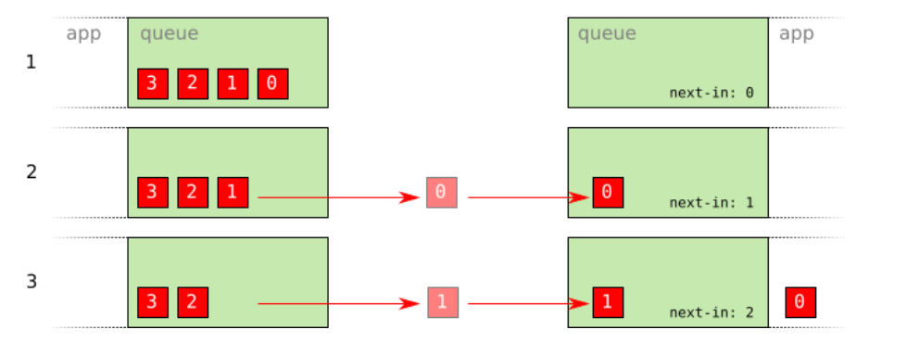
Sequence Number
Consider problems of packet loss

Slide 4
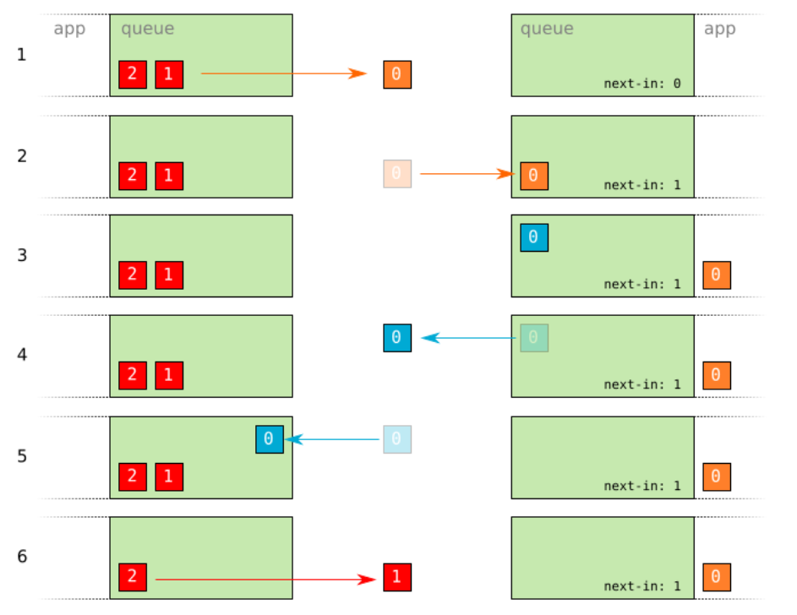
ACK
Sender has to resend packets if it doesn’t receive ACK.

Slide 5
3 Different Timeout Methods
Timeout using SIGALRM
Timeout using select
Timeout using setsockopt

Slide 6

SIGALRM
For some linux distribution, you may need to use siginterrupt to allow SIGALRM signal to interrupt syscalls when using SIGALRM timeout method.
Use ualarm() to schedule signal after given number of microseconds.

Slide 7
Makefile
From this homework, you must use Makefile to compile your codes. And you need to upload your Makefile with your codes. If you don't use Makefile, we will not let you demo your homework.
You need to learn how to use Makefile by yourself.

Slide 8
Makefile
Reference
https://www.youtube.com/watch?v=aw9wHbFTnAQ
http://maxubuntu.blogspot.tw/2010/02/makefile.html

Slide 9
Requirement
The usage of the executable files should be like below.
./sender_sigalrm [send filename] [target address] [connect port]
./receiver_sigalrm [save filename] [bind port]
After finishing the transmission, both sender and receiver should terminate automatically.
Makefile should have "make" function to compile all files and "make clean" function to remove all compiled files.

Slide 10
Network Environment
To test your programs, you need to simulate packet loss events by using tool ‘tc’ (traffic control).

Slide 11

Network Environment
You can use the following command to set the packet loss rate and packet delay.
sudo tc qdisc add dev <Device> root netem loss <Packet Loss Rate> delay <Delay Time> <Variation> distribution normal
For example, the command below set the packet loss rate to 5%, delay time to 7ms~13ms on device lo.

Slide 12

Network Environment
To delete the network setting, you should use the following command.
sudo tc qdisc del dev <Device> root
For example, you can use the command below to delete the rule.

Slide 13
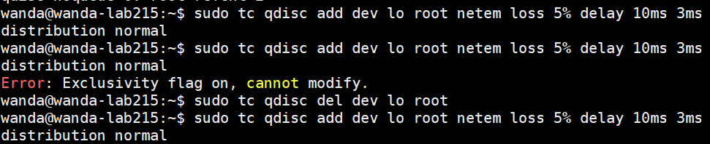
Network Environment
If the following error occurs when adding a rule, try to delete rules first.

Slide 14
Network Environment
You should not run your programs on the workstation (i.e. npbsd, nplinux, bsd, and linux). Instead, you do that on your own PC.

Slide 15
Check Correctness
Use tool ‘diff’ to check if the file transfer is correct.
Usage: diff <File 1> <File 2>
If two files are the same, it shows nothing, or it shows the difference.

Slide 16
Grading Policy
Timeout using SIGALRM (30%)
Timeout using select (30%)
Timeout using setsockopt (30%)
Makefile (10%)
Performance (+20%)

Slide 17
Grading Policy
We will test your programs with packet loss rate less than 10% and the transferred file size will be less than 1MB.
Your programs should finish file transferring in 1 minute.

Slide 18
Performance (BONUS +20)
(Optional)
For the performance test, we will test your program with different packet loss, limited link bandwidth, non-zero RTT, and variable queuing delay.
You can only choose one retransmission mechanism that you implement (SIGALRM, select, or setsockopt) to participate in the competition.
Please upload the bonus to assignment homework2_bonus.
Check the grading policy for this bonus in the spec.

Slide 19
Due Date
2021/12/13 23:55
Submit your code to e3 and put all code under same folder named <Student ID> (DO NOT ZIP FILES).
Example hand-in format: 301234567 ├── Makefile ├── sender_sigalrm.c/cpp ├── receiver_sigalrm.c/cpp └── ……
If you have any questions, please contact TAs.

